Slide 1
Deciphering the Epigenetic and Spatial Dynamics of Caner Associated Fibroblasts and CD8+ T-Cells in Colorectal Cancer Metastasis and Recurrence
Alos Diallo

Slide 2
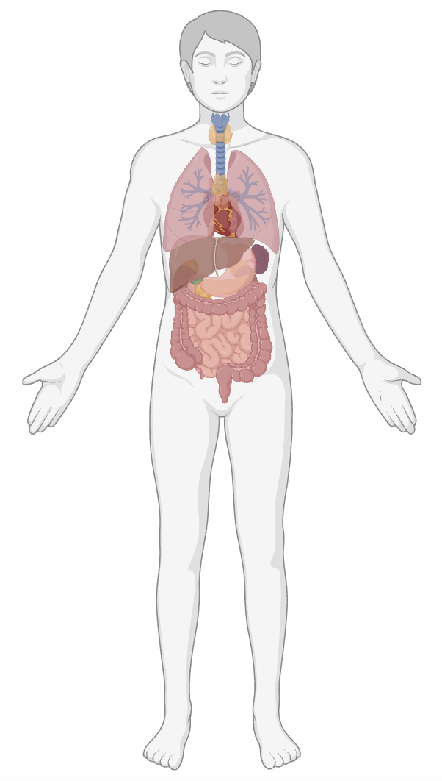
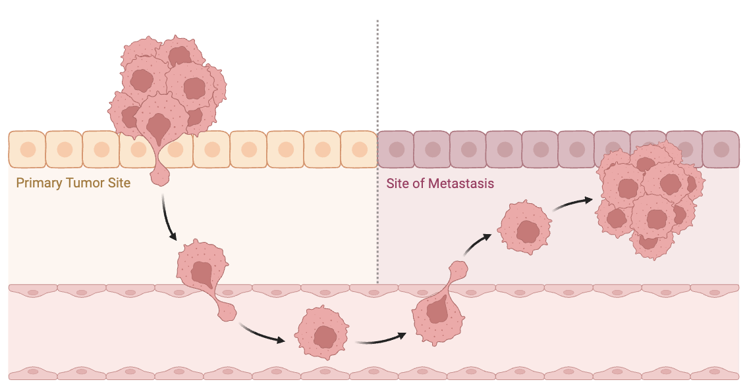
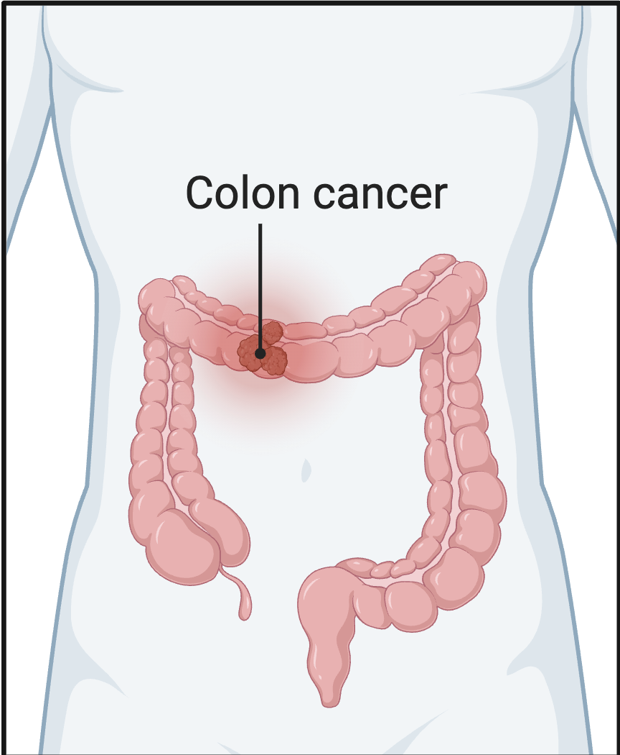
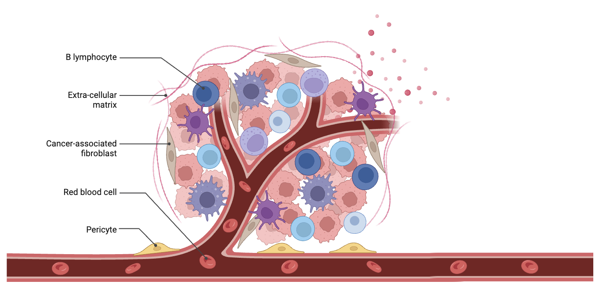
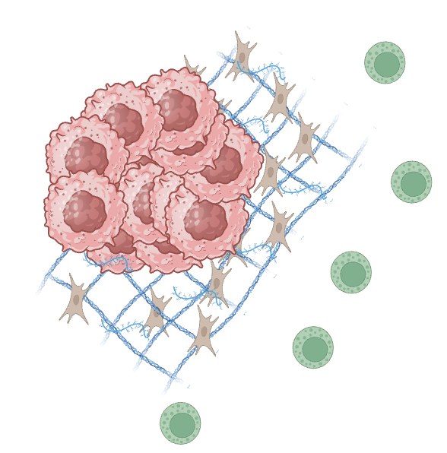
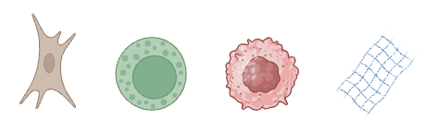
Biological Problem
DH Patient
Cancer Diagnosis
Metastasis
Tumor Microenvironment
Interactions
CAF’s
CD8+ T-Cell
Tumor Cell
Extracellular Matrix

Slide 3
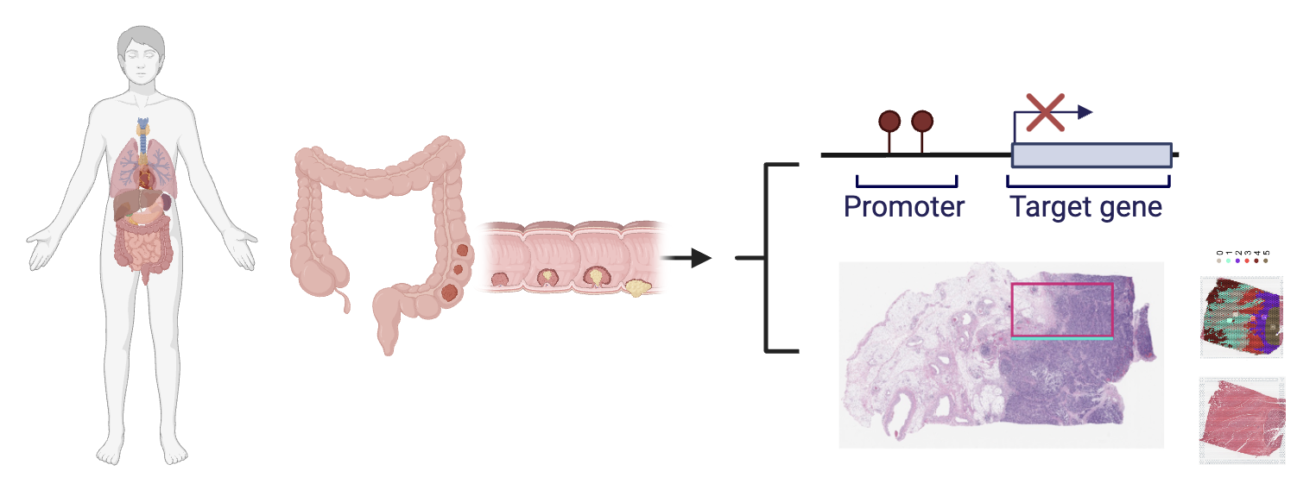
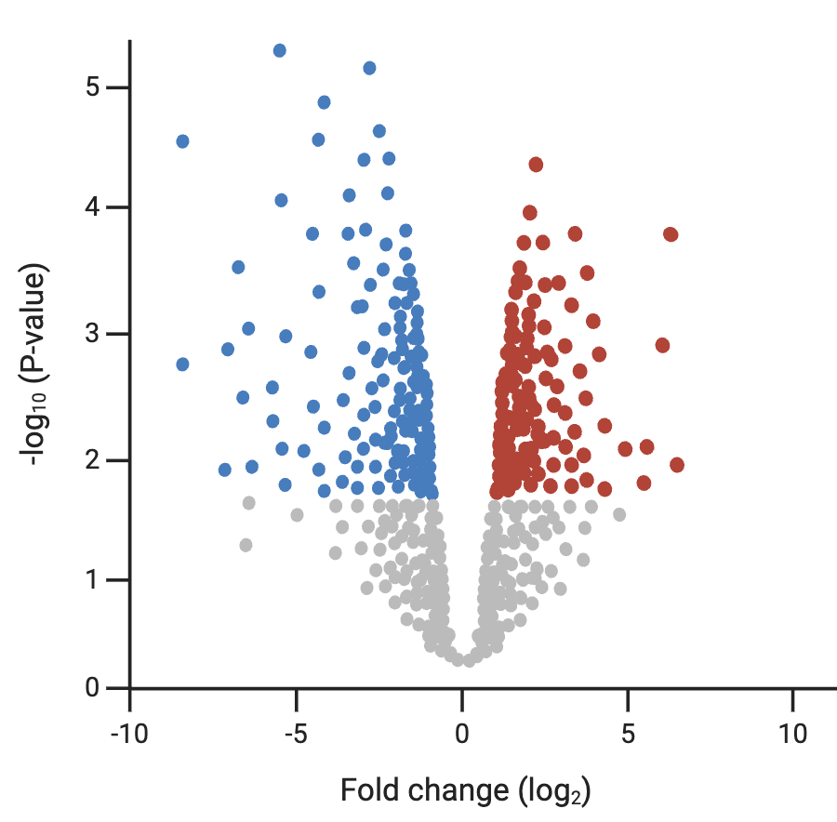
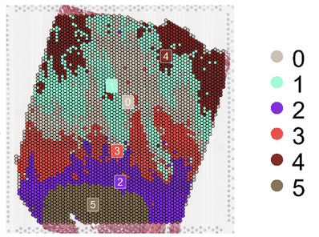
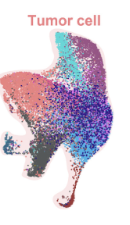

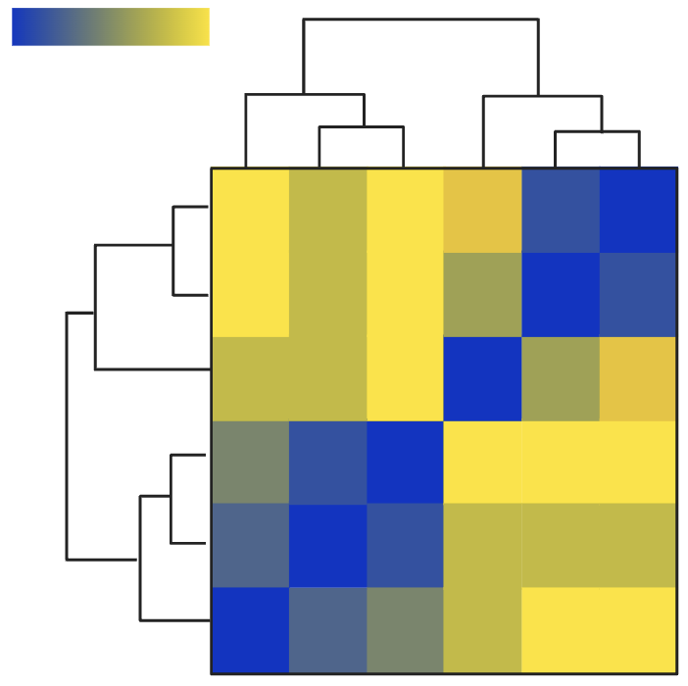
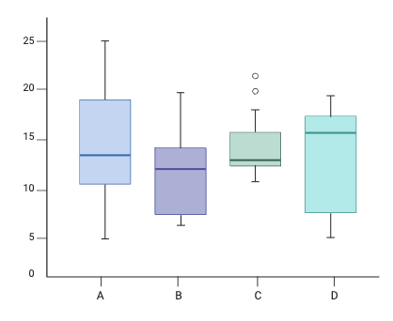
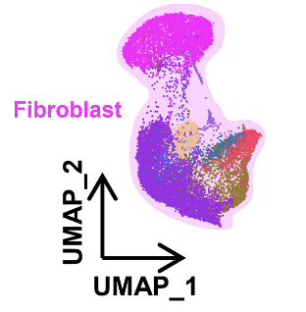
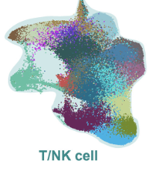
Data and Experimental Design
Patient Admitted to DH
DNA Methylation Data
Colon Biopsy from pT3 patients (N = 58)
Multiomic Data
AIM 1 DNA Methylation Analysis
AIM 2 Multiomic Analysis
AIM 3 Integrative Analysis

Slide 4
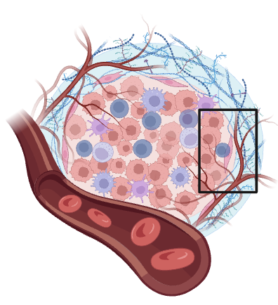
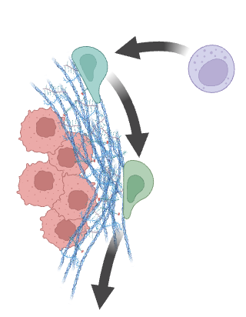
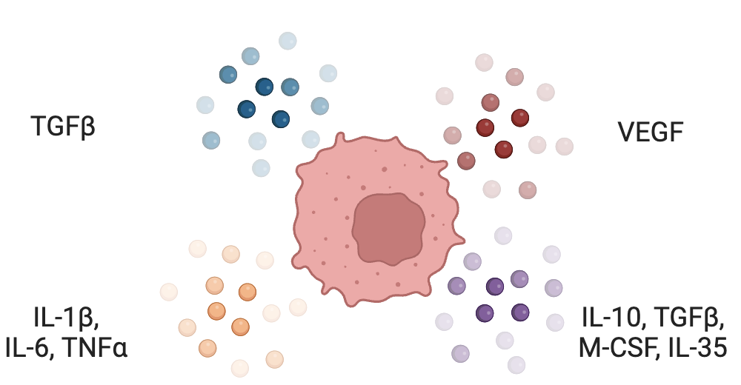
Study Motivation
We hypothesize that by studying the multiomic and epigenetic signatures of CAFs and CD8⁺ T-cells within the TME, we will uncover new insights into T-cell exhaustion and how tumors evade the immune system in colorectal cancer.
Our overall objective is to better map the spatial and epigenetic relationship between CAFs and CD8⁺ T-cells in the TME

Slide 6
Old source material

Slide 7
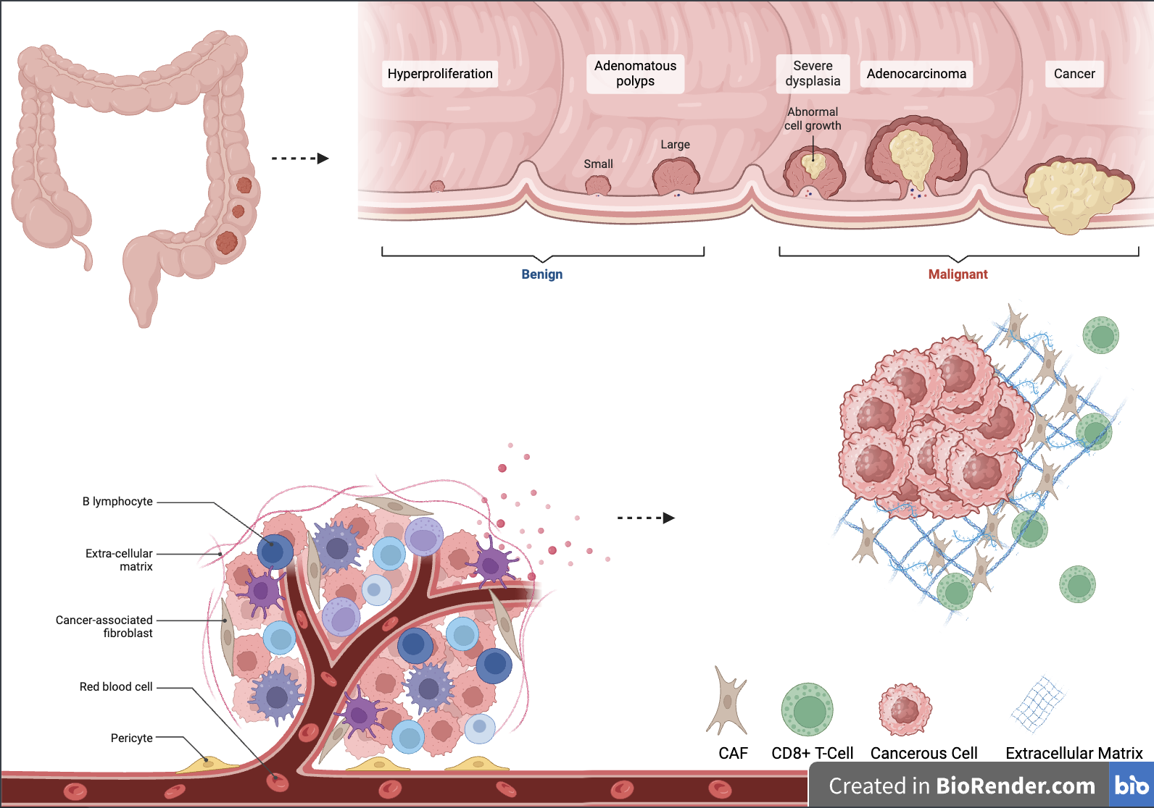

Slide 8
